Slide 1

· · ·
WEB SITE EXIA BDE
By Exia

Slide 2









Summary
Group Présentation
Context
Student
Salary
BDE
Quote
Future trend
Project Management
Conclusion

Slide 3

Group Presentation
1

Slide 4

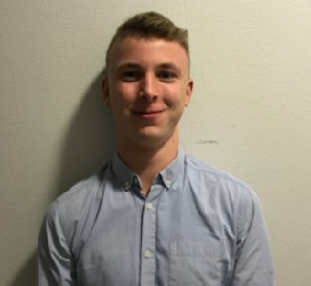
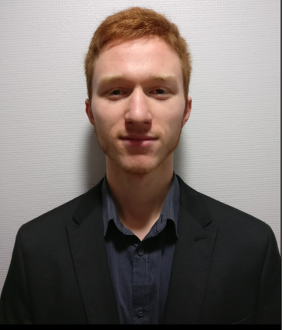
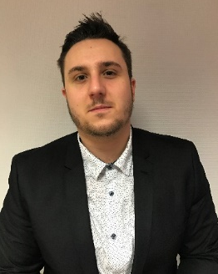
Group presentation
HOYEZ Alexis
PODEVIN J-Clément
GEERAERT Pierre
NAESSENS Valentin
Front and Back Dev
Front and Back Dev
BDD - Back
BDD - Back
Notes:
Pierre

Slide 5
2
Context
Notes:
Pierre

Slide 6

Context
The Need
Have a Web Site with differents options for different grades :
- Student
- Employees of the Cesi
- BDE Members
Constraints
Respect the graphic charter
Use modern tools
Time : two weeks
Ergonomic web site
Notes:
Pierre

Slide 7




Tools

Slide 8
3
Demo : Student
Notes:
Register → Pierre
Valentin
Purpose an idea , like a event , vote for an idea , buy something

Slide 9
Salary
4
Notes:
Tutor : Signal nocif element in event , and download photos , same like sutentd Alexis

Slide 10
5
BDE
Notes:
Allexis ->check message in notifications → Jc , Add or del an article , event.
list of register for an event , admin past event

Slide 11
6
Quote
Notes:
Valentin

Slide 12


3
Quote
The hosting made by OVH :
Use the offer Kimsufi for 1,49€ /Month
For the domain name BDE-EXIA-Arras.fr which will cost 6,99€/Month
→ Stable , reliable and secure web site due to the experience of OVH
Notes:
Valentin

Slide 13
Future trend
7

Slide 14
Future trend
Hosting
Visual aspect
Responsivness
Create an API
Use a Framework
MVC
Notes:
Pierre : Hebergement – Alexis : Aspect visuel , responsivv – Valentin – API , Framework – JC : MVC Mal

Slide 15
8
Project Management

Slide 16
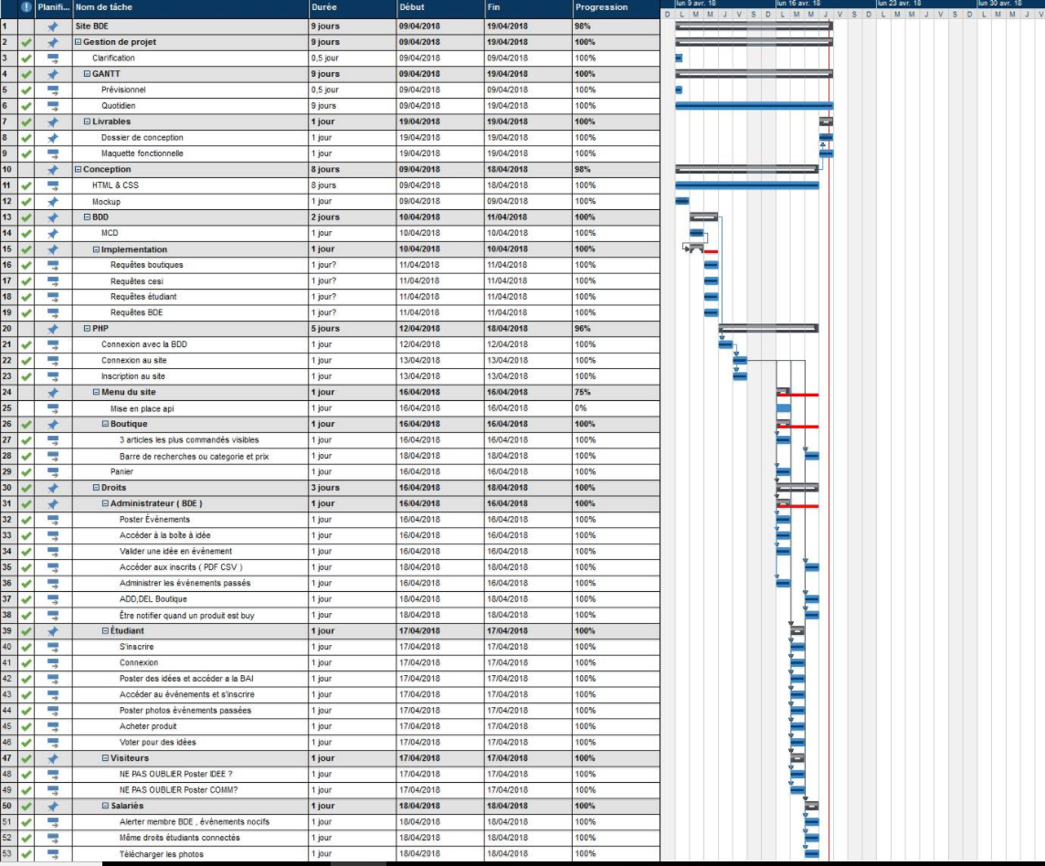
Notes:
Pierre : Expliquer différentes taches

Slide 17
9
Conclusion
Notes:
Pierre : projet qui c’est bien apsser , on a essayer de rendre un site beau , responsive , on a appris des choses.

